Slide 1
Final Project (Automata Theory)
Subhrajyoti Pradhan
U79333962

Slide 2
CYK Algorithm
For this project I decided to create a program that accepted a grammar in Chomsky Normal Form and discerns whether a given string belonged to that particular Grammar.
We employed the use of CYK Algorithm, which is a parsing algorithm and employs dynamic programming.
Only grammar in Chomsky Normal Form were accepted

Slide 3
What is CYK Algorithm
Cocke–Younger–Kasami algorithm is a parsing Algorithm.
Uses Bottom up parsing, and Dynamic Programming on Context free grammar.
Only accepts grammar in Chomsky normal form ( however works for all CFG as they can be converted to this form).
Is used to discern whether a given string belongs to a grammar.

Slide 4
Steps Taken
In the first step we write the word in the first row and add each non-terminal symbol in the row underneath which deduces the terminal symbols. After that, for each cell in the grid start vertically at the top and go down towards the cell to be checked and the second cell up in diagonal. For each such step, combine the cells and check if the combination appears in the grammar. If it does, add the left-hand-side non-terminal to the grid-cell. If after all steps the start-symbol is contained in the last row, the word can be derived by the given grammar.

Slide 6
Pseudocode
let the input be a string I consisting of n characters: a1 ... an.
let the grammar contain r nonterminal symbols R1 ... Rr, with start symbol R1.
let P[n,n,r] be an array of booleans. Initialize all elements of P to false.
for each s = 1 to n
for each unit production Rv -> as
set P[1,s,v] = true
for each l = 2 to n -- Length of span
for each s = 1 to n-l+1 -- Start of span
for each p = 1 to l-1 -- Partition of span
for each production Ra -> Rb Rc
if P[p,s,b] and P[l-p,s+p,c] then set P[l,s,a] = true
if P[n,1,1] is true then
I is member of language
else
I is not member of language

Slide 7
The Code
I used C++ to code the program
The code asks the user to enter a grammar.
A function discerns whether the code is in Chomsky normal form
We then proceed to take in a string from the user if grammar is CNF. (break the grammar and use simple if else to check if this belongs to the range of alphabets).
We put that string into a matrix and discern whether it belongs to the grammar.

Slide 8
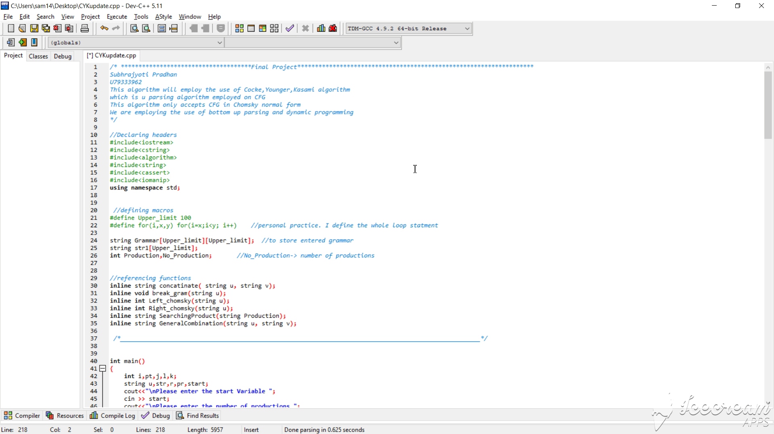

Slide 9
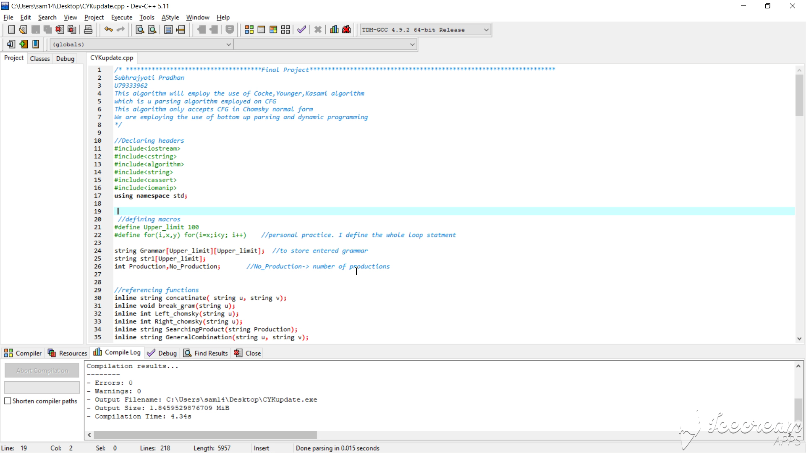

Slide 10
THANK YOU

